Slide 1
About me
Hena Ghonia
Associate Data scientist at Ecolab.
Work around Python, Sql.

Slide 2
Hyperparameter-tuning using Dask
https://github.com/dask/dask-ml

Slide 3
Agenda
What’s hyperparameter tuning
A new paradigm in hyperparameter optimization
Scaling hyperparamter searches
Adaptive Hyperparameter optimization

Slide 4
What’s hyperparameter tuning
A free parameter not learned from data.
Defines how well model trains.
Split data
Choose Hyperparameter
Score model -> Validation set
Using Best hyperparameter to train on complete data
Train data
Test data
https://www.youtube.com/watch?v=x67K9FiPFBQ

Slide 5
A new paradigm in hyperparameter optimization
Passive algorithms (do not adapt to previous training) [1]
RandomizedSearchCV and GridSearchCV
Adaptive algorithms(Use information from previously trained configurations to inform which hyperparameters to train next)[1]
Bayesian searches- Sequential model-based optimization, tree-structure Parzen estimator and Spearmint - ROBO package through AutoML.
[1] Sievert, Scott, Tom Augspurger, and Matthew Rocklin. "Better and faster hyperparameter optimization with Dask." Proceedings of the 18th Python in Science Conference, Austin, TX, USA. 2019.

Slide 6
In the parallel setting, practitioners default to use random/grid search[1]
Trivial to parallelize and easy to scale to any number of machines.
For adaptive search algorithm: avoid extra computation and find high-performing hyperparameters quickly.[1]
Difficult to parallelize and scale
[1] Sievert, Scott, Tom Augspurger, and Matthew Rocklin. "Better and faster hyperparameter optimization with Dask." Proceedings of the 18th Python in Science Conference, Austin, TX, USA. 2019.

Slide 7


Scaling hyperparameter search[2]
Memory constrained : Datasize too large to fit in memory.
Compute constrained : Computation takes long time even with data that fit in memory.
4 combinations:
Compute constrained, but not memory constrained
Memory & compute constrained
Compute
constrained
Avoid repeated work
Neither memory nor compute constrained
Memory constrained, but not compute constrained
Compute
Memory
Memory constrained
https://ml.dask.org/hyper-parameter-search.html

Slide 8
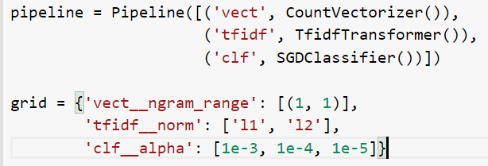
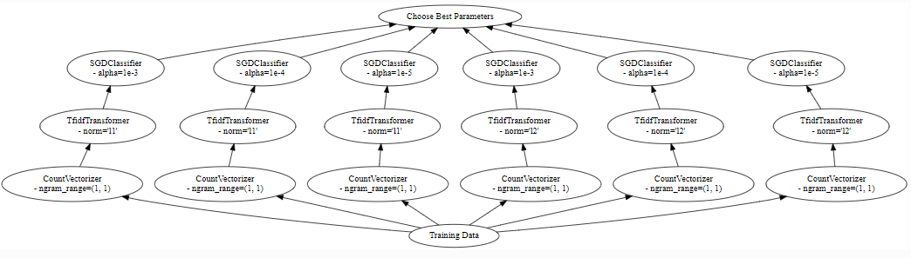
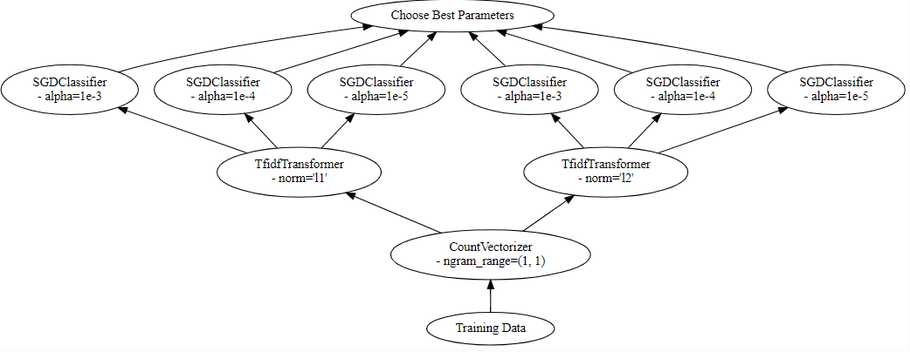
Avoid repeated work[2]
Scikit-Learn grid-search
Dask-ml grid-search
https://ml.dask.org/hyper-parameter-search.html

Slide 9
Adaptive hyperparameter optimization[2]
Dask-ml: using Principled-early stopping scheme in its adaptive search
Hyperband search
Successive halving search
Inverse decay search
https://ml.dask.org/hyper-parameter-search.html

Slide 10
Successive Halving3]
s5
.
.
.
Repeats this until one estimator survives.
s2 | s5 | s7 | s8
Train the surviving estimators for twice as long
Evaluate the performance of all set of estimators
Promote top half performing set
s1 | s2 | s3 | s4 | s5 | s6 | s7 | s8
Train set of estimators for a certain number partial_fit calls
Hyperparameter configurations
https://blog.ml.cmu.edu/2018/12/12/massively-parallel-hyperparameter-optimization/

Slide 11
Successive Halving[3]
dask_ml.model_selection.SuccessiveHalvingSearchCV generalizes by parameter – aggressiveness
Promotes 1//aggressiveness fraction of estimators to next iteration
Trains set of estimators for aggressiveness times longer.
For example, aggressiveness=4
s5
. . .
s2 | s4 | s5 | s9
Train the surviving estimators for 4 times as long
Evaluate the performance of all set of estimators
Promote top 4 performing set
s1 | s2 | s3 | s4 | s5 | s6 | …. | s16
Train set of estimators for a certain number partial_fit calls
Hyperparameter configurations
https://blog.ml.cmu.edu/2018/12/12/massively-parallel-hyperparameter-optimization/

Slide 12
Hyperband Search[4]
Speeding up random search through adaptive resource allocation and early stopping.
When to stop training of models →how training data affects the score.
Two extreme:
Hyperband balances between these 2 conditions to frequently stop training.
Finds best model with minimal partial_fit calls.
only training data matter | Only hyperparameters matter
https://www.youtube.com/watch?v=x67K9FiPFBQ

Slide 13
Inverse decay search[5]
Starts training on small amount of data with set of estimators.
At time k, will retain 1/(k+1) fraction of highest performing set of estimators.
Parameter decay_rate determines how quickly decrease in future partial_fit calls will occur.

Slide 14

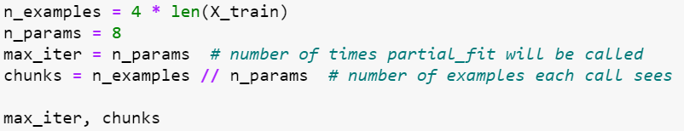
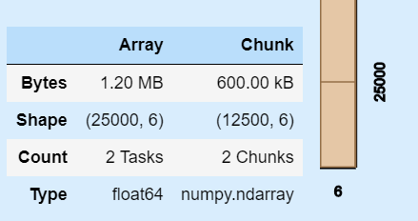
Example
Create dask cluster on local machine: 4 cores, 4 workers
Create data synthetically(shape: 30000x6) and split into train (25000) & test(5000)
https://examples.dask.org/machine-learning/hyperparam-opt.html

Slide 15
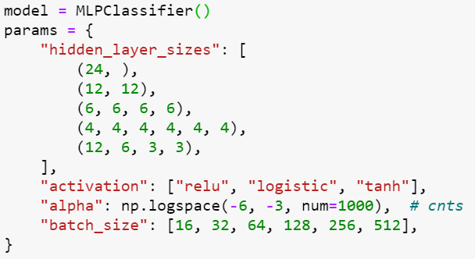
Example continued...
Algorithm | Time | Best_score
 | 3min 4s | 0.601
 | 3 min 58s | 0.854
 | 10.1 s | 0.5056
https://examples.dask.org/machine-learning/hyperparam-opt.html

Slide 16
Successive Halving
Dask cluster: 16 cores, 16 workers, memory: 67.27GB
Dataset: Numerai tournament[6],
Size : 1.2 GB, Features: 310, No. of rows: 501808, 288 set of combinations
[6] https://docs.numer.ai/tournament/learn

Slide 17
Summary
Returns best hyperparameter more quickly with less passes through data and certainty.
Pytorch implementation using skorch.
Successive halving, Hyperband, InverseDecay search supports model that implement partial_fit.

Slide 18
Thank you!
Linked in : https://www.linkedin.com/in/hena-ghonia-0876aa129/
Presentation link: https://github.com/Hstellar/wids_mysuru_2020
Gmail : hena.g.btechi15@ahduni.edu.in

